Slide 1


Presented By:-
Rishabh Kumar
40314002018
BCA 3rd Year, 1st Shift

Slide 2
ABSTRACT
BLOOD BANK management system is a desktop based application on Java. The purpose of this project was to develop a blood management information system to assist in the management of blood donor records and sells record. This project includes mainly two modules i.e. login and main page.
The current system is manual and it is time-consuming. It is also cost-ineffective, and the average return is low and diminishing.

Slide 3
OBJECTIVE
This software helps to easy management of records such as management of blood donors, sells and no. of blood packets available etc.

Slide 4
NEED OF THE SYSTEM
There is always a need of a system that will help in blood bank to manage information of available blood packets of a corresponding blood group.

Slide 5
PROJECT SCOPE
The project has a wide scope, as it is not intended to a particular organization. This project is going to develop generic software, which can be applied by any businesses organization. More over it provides facility to its users. Also the software is going to provide a huge amount of summary data.

Slide 6
MODULES
Manage Donor Information
Manage No. of Blood Packets Available
Manage Buyer information

Slide 7

FRONTEND (LANGUAGE USED)
Java(Swing)

Slide 8

BACKEND
MYSQL (DATABASE)

Slide 9
SOFTWARE USED
JDK (Java Development Kit)
Netbeans IDE(Integrated Development Environment)
MYSQL WorkBench / XAMPP(for Mysql)

Slide 10
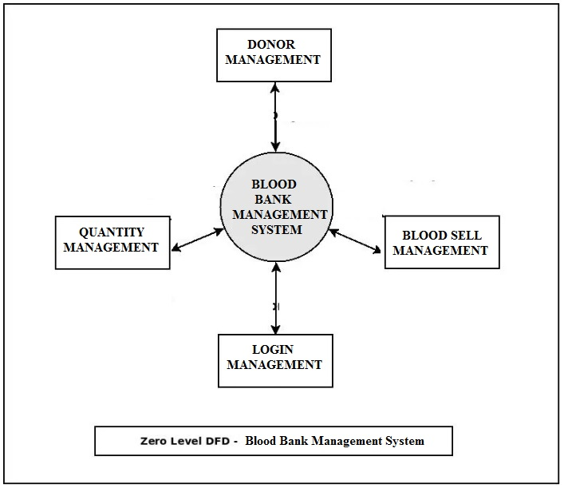
DFD(DATA FLOW DIAGRAM)

Slide 11
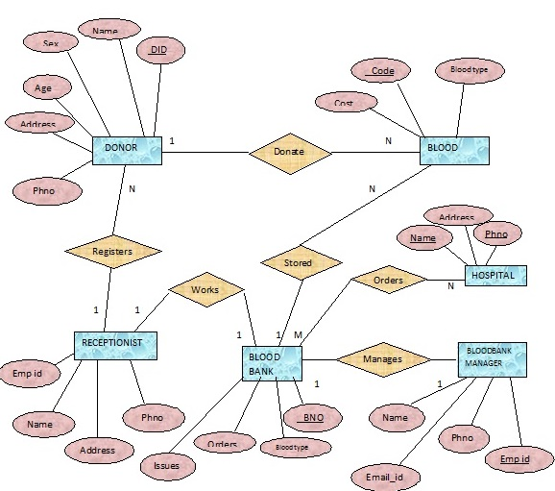
ER DIAGRAM

Slide 12
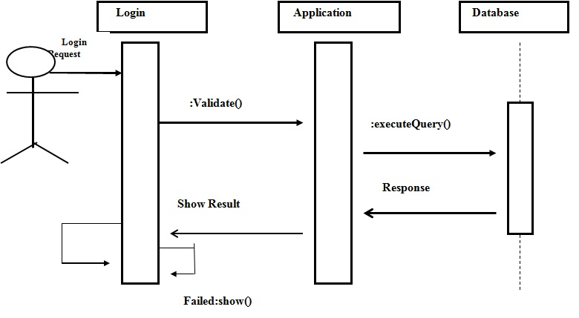
SEQUENCE DIAGRAM

Slide 13
USE CASE DIAGRAM
Use case diagram consists of use cases and actors and shows the interaction between them. The key points are:
The main purpose is to show the interaction between the use cases and the actor.
To represent the system requirement from user’s perspective.
The use cases are the functions that are to be performed in the module.
An actor could be the end-user of the system or an external system.

Slide 14
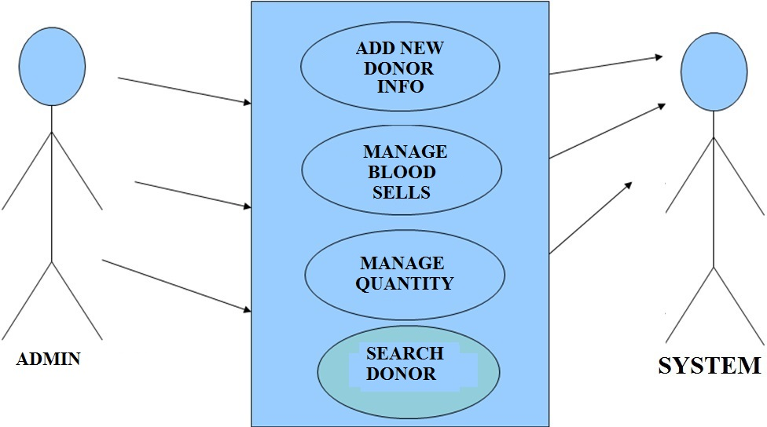

Slide 15
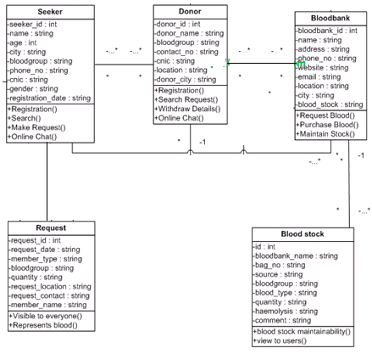
CLASS DIAGRAM

Slide 16

SPLASHSCREEN FRAME

Slide 17
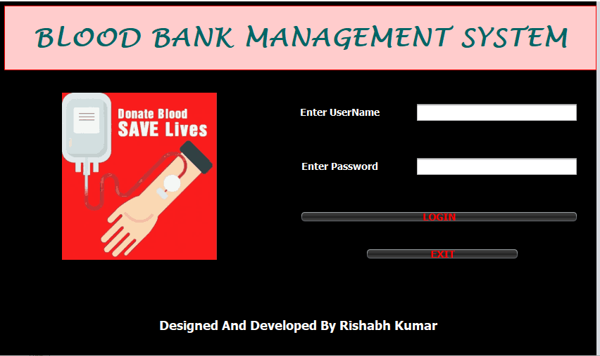
LOGIN FRAME

Slide 18
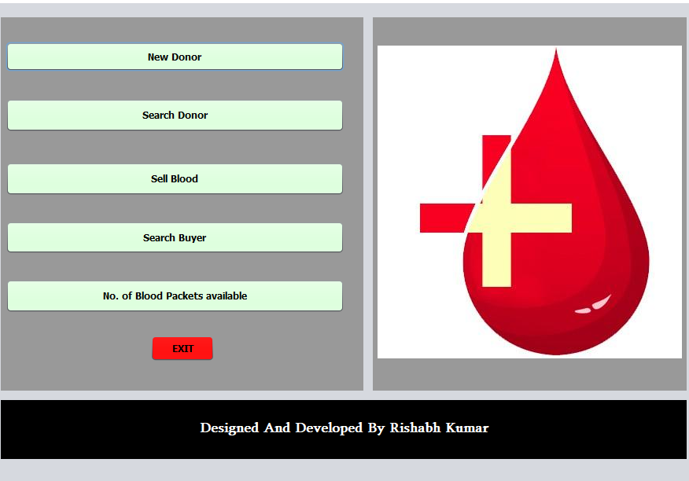
ADMIN DASHBOARD

Slide 19
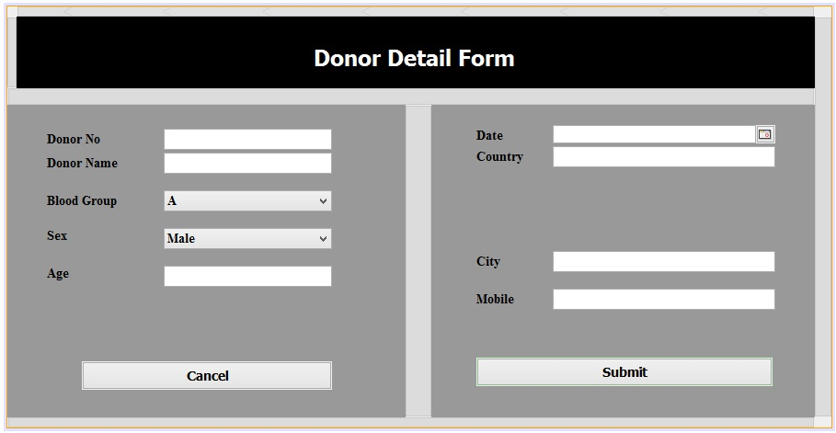
ADD NEW DONOR

Slide 20
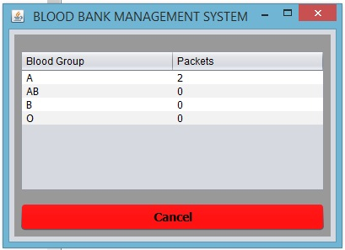
BLOOD PACKETS AVAILABLE

Slide 21
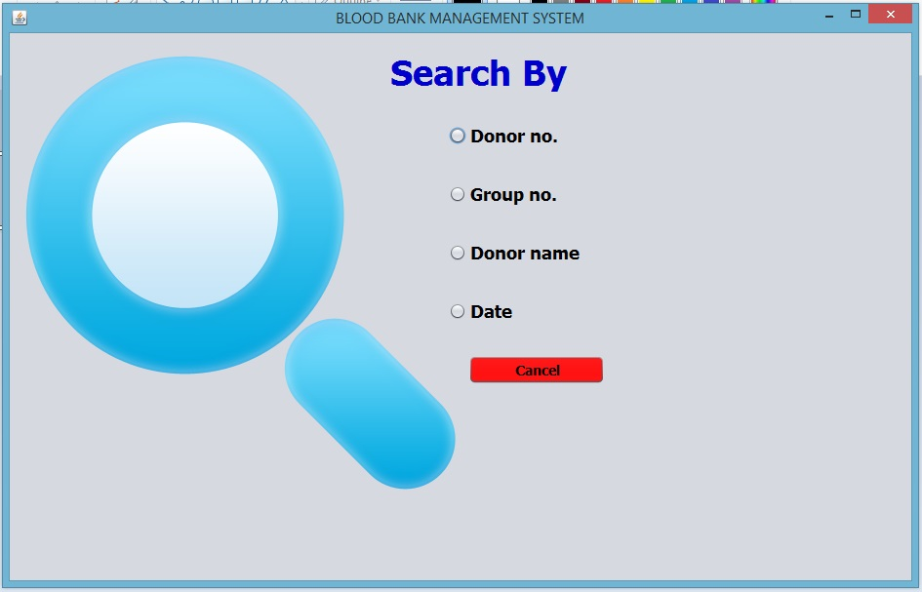
SEARCH DONOR

Slide 22
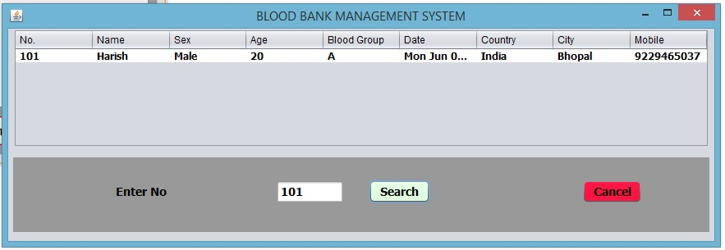
VIEW DONOR RECORD

Slide 23


Slide 24
CONCLUSION & FUTURE SCOPE
FUTURE SCOPE
This web application involves almost all the basic features of the blood bank management. The future implementation will be online help for the customers and chatting with administrator.
CONCLUSION
The project entitled “Blood Bank Management System” is developed using JAVA swing as front end and MYSQL database in back end to computerize the process of blood bank management. This project covers only the basic features required.

Slide 25
BIBLIOGRAPHY
Wikipedia
www.java.sun.com/docs/books/tutorial
Kathy Sierra book
Wrox professional Java
www.javatpoint.com

Slide 26
THANKYOU

